Slide 1
Btech 451 Project
Saketh Vishnubhotla

Slide 2

Aim
Raise awareness about the Dynamic Earth through educational Seismology

Slide 3

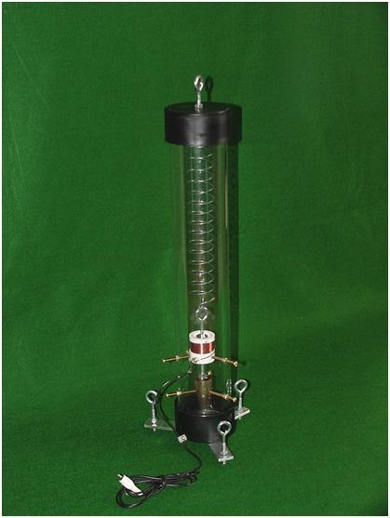
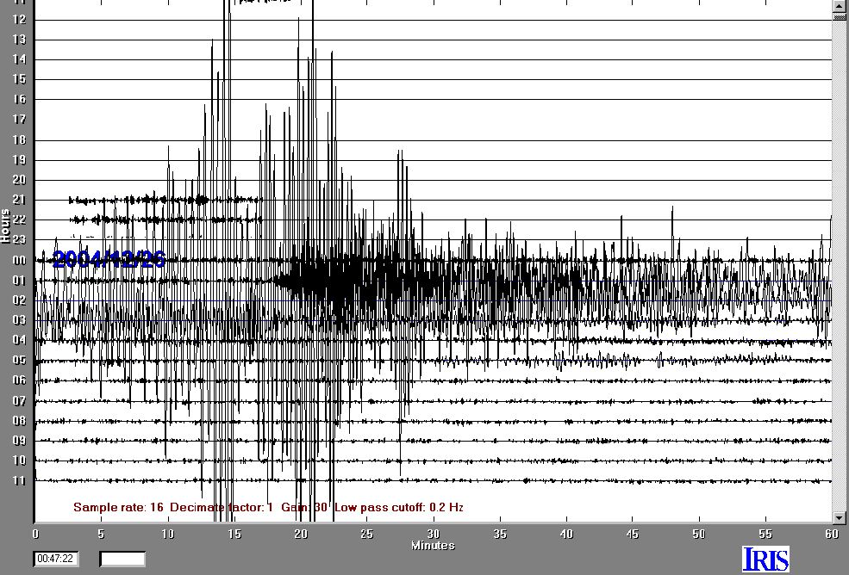
Current Situation

Slide 4
Problem
Complex Software Application
jAmaseis is NOT open source
jAmaseis developed and maintained by a handful of devs

Slide 5
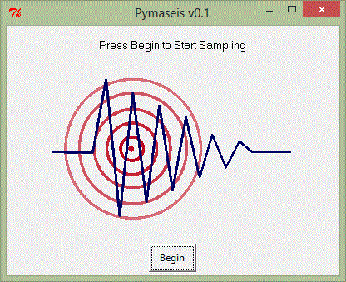
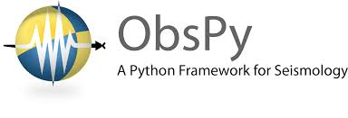

Solution

Slide 6
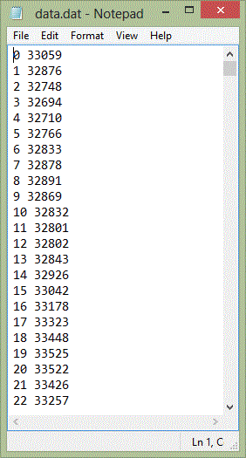
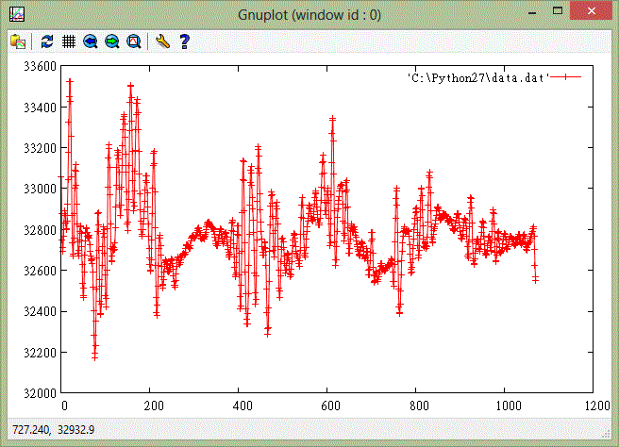
Initial Progress

Slide 7
Plan of Action
Display live data
Upload mseed files to seedlink server
Download and display others’ mseed files

Slide 8
Thank You!
Questions?

